Slide 1

URStreamSight
Computer Vision & Data Visualization for Identifying Contaminants in Residential Curbside Recycling

Slide 2

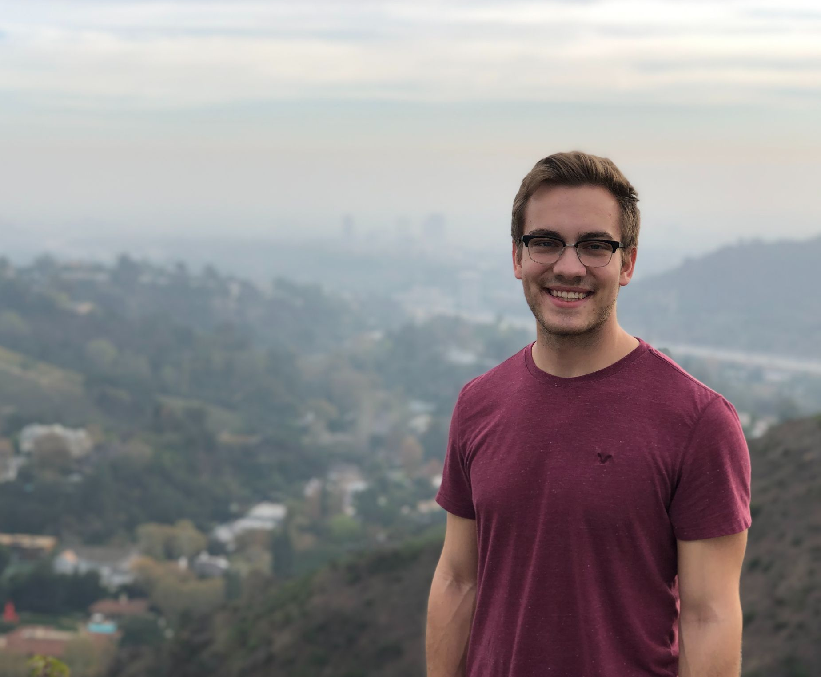

The Team
Avery Cameron
Project Manager and Flexible Developer
Raymond Knorr
Lead API and Front-End Developer
Noah Rowbotham
Lead Machine Learning Technician

Slide 3
Commercial
Notes:
Just to briefly introduce you to our project, here is a commercial for our product StreamSight.

Slide 4


Slide 5
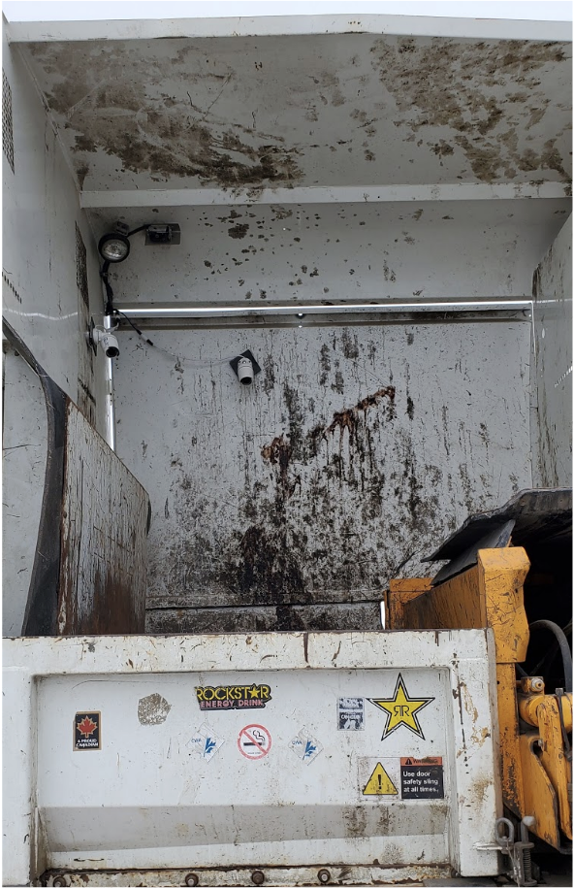
What is URStreamSight?
Problem:
Citizens across Canada are confused regarding what proper recycling is.
Gap we are filling:
Giving data to municipalities to allow them to track/correct problem at its source (the people recycling). We are not actually sorting any recycling.
Innovation we are introducing:
Web application for municipality workers that scores recycling on a neighborhood basis and displays the data. Videos are captured from the bin of recycling trucks and ran through a waste classifier to determine whether the recycling is contaminated.
Notes:
URStreamSight is a web application to help reduce recycling contamination by providing reports to municipality workers and allowing them to review contamination in recycling bins to help with decision making.
Pictures are captured when a bin is tipped into the recycling truck and contamination is identified with machine learning, the results are then displayed in our front-end portal for users.

Slide 6
Why Make URStreamsight?
Contaminated recycling generates fines for municipalities
Sorting recycling is complicated and expensive
Our three pillars:
Education
Regulatory compliance
Iteration
Notes:
Thirty percent of all the material that is recycled is actually garbage. Garbage found in recycling is known as recycling contamination. Contaminated recycling generates fines for municipalities which increases costs for households. If the contamination is bad enough, recycling centers will close down, and people will be forced to throw everything in the trash. If the recycling is clean, recycling can instead provide revenue.
https://www.recycleacrossamerica.org/us-recycling-collapse
We have a 3 Pillar approach:
Education: The first step to fixing behavior is to raise awareness
Regulatory Compliance: The use of fines or loss of service to improve behavior. Additionally, money from fines could be put straight back into education
Iteration: Analyzing results of these two approaches to determine the best method or combination. Also in iteration, our machine learning model will continue to get better as more pictures are gathered.
Our app provides these pillars to municipalities to help improve their recycling and reduce contamination.

Slide 7
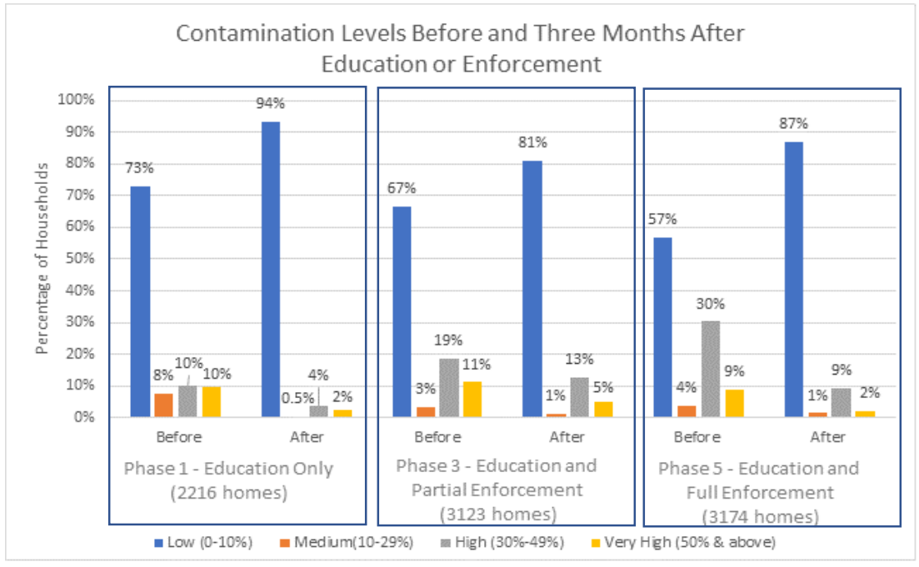
Region of Peel Findings
Our three pillars:
Education
Regulatory compliance
Iteration
Studies on recycling contamination impacts such as a study from the Region of Peel (in Ontario) showed that after education campaigns, contamination in recycling greatly improved.
Results from the region of Peel
Notes:
Proof of the effectiveness of this approach is shown in the study from the Region of Peel in Ontario.
The Region of Peel encompasses the cities Mississauga, Brampton, Caledon and several others
Contamination of recycling costs the Region of Peel over $3.6 million each year. It also puts the Region’s ability to successfully sell recycling at risk.
Curbside pilot findings showed that approximately 60-70 percent of curbside households had less than 10 percent contamination in their blue box, and that after education alone that number rose to 80-90 percent. You can see these numbers reflected in phase one of the graph. These results align directly with our app’s first pillar.

Slide 8

Our Partnership
Developed in cooperation with our industry partner, Prairie Robotics
Progress made in our project will be used and expanded on by Prairie Robotics following its completion
Notes:
This capstone opportunity was made available to us by Prairie Robotics, a local startup here in Regina and it will be adopted and expanded on by them following its completion. We also applied for and received Mitacs funding to help with this project.

Slide 9
Our App
Notes:
Ray give Front-End Demo
Just mention education and potential fees and compliance
That is it for our front-end demo. So, the next question would be: Where is this data coming from?
Give more of an explanation, take a bit of time

Slide 10
Point of Collection
SSIO (StreamSight Input/Output)
Two cameras mounted in recycling collection vehicle
Captures video of bin as it is being tipped
Uploads images with timestamp and GPS coordinates
How do we isolate only the images of the bin being tipped?
Notes:
The collection of contaminated recycling at its source starts with our tool StreamSight Input/Output or SSIO for short.
SSIO has a variety of different functionality that all works together to collect and upload data as recycling bins are emptied into the truck.
SSIO includes controlling two cameras seen on the right of the slide. The the left camera detects the presence of a recycling bin and the rightmost camera records images of the recycling in bins after they are emptied.
We use the individual images to identify the contaminants that are present within a households recycling.
SSIO also uploads each set of images with a timestamp of when the bin was tipped and the gps coordinates of the trucks position when the bin was collected. We can use the coordinates to later relate a bin’s location back to a specific household.
So, SSIO collects images of the contents of each bin, how does it know when to start and stop taking images? How does it know what images belong to what bin?

Slide 11

Rear Camera View
Notes:
Here is an example of what the camera that captures bin contents sees.

Slide 12
Top Camera View
Notes:
This is an example of the footage that detects the bin sees.

Slide 13
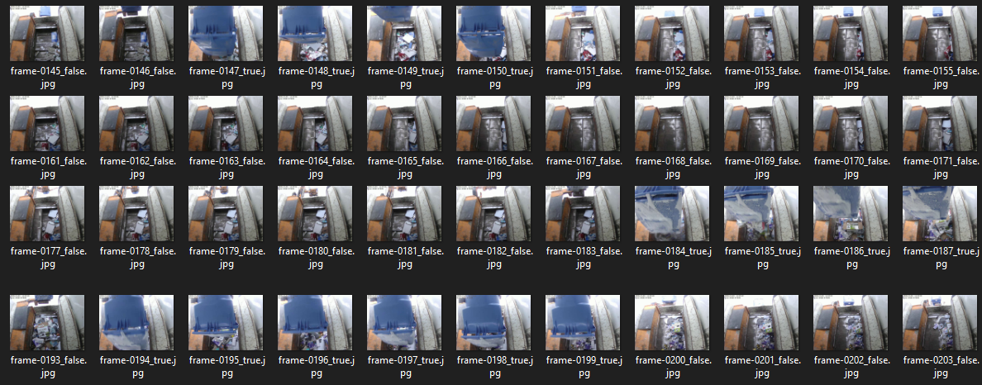
Bin Detector
Bin Tip #1
Contents of Bin Tip #1
Notes:
SSIO uses machine learning to see the blue bin. When it sees the blue bin, it triggers the cameras to start recording images.
The collection you see here demonstrates the model detecting three individual bin tips occurring in succession.
The camera records the frames that you see highlighted in blue, which are the contents that were dumped from the previous bin tip labeled #1.

Slide 14
Bin Detector - Train
Trained over 3 rounds, approximately 3500 images of data each round
99% of the time, the model will correctly determine if a given image contains a bin or not
Notes:
Bin detector was trained over three rounds. Each round approximately 3500 images were used as training data.
The model can correctly determine if a bin is visible 99% of the time.
So we know how we detect bin tips, how are we identifying contaminants?

Slide 15
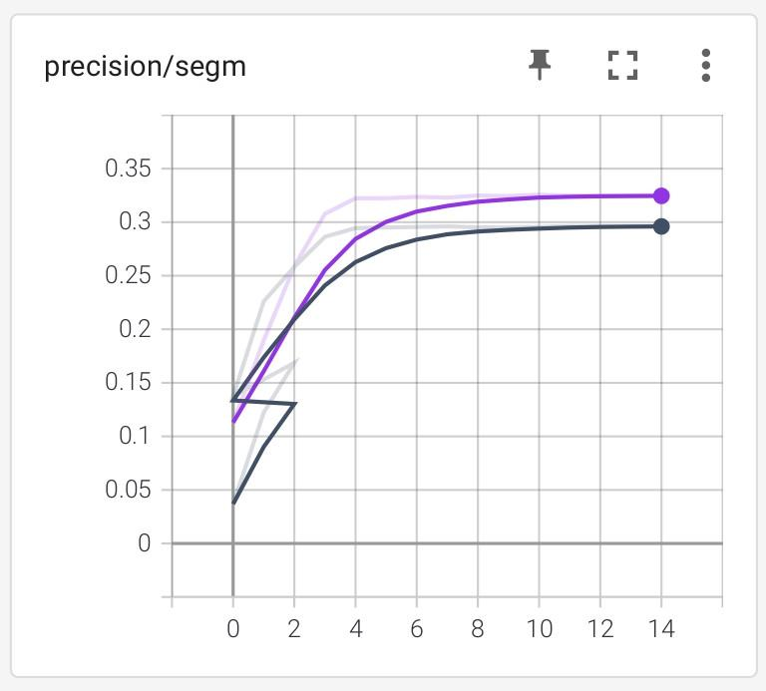
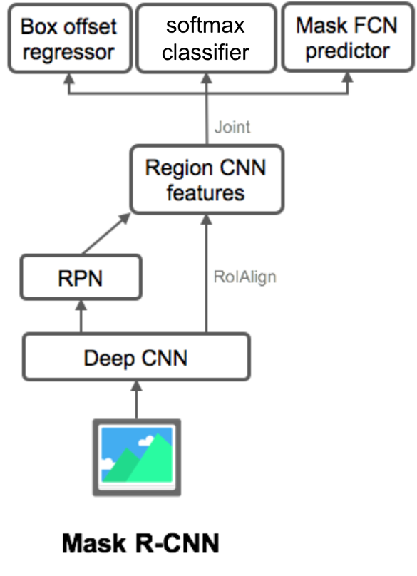
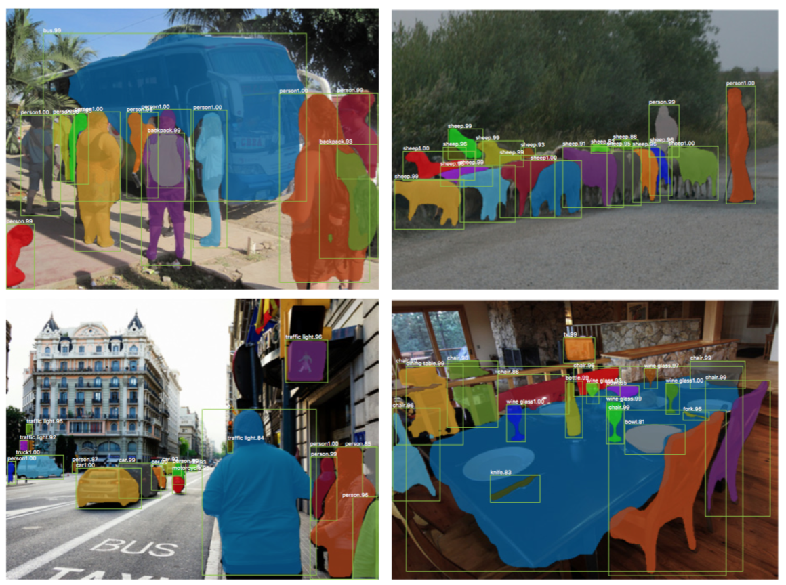
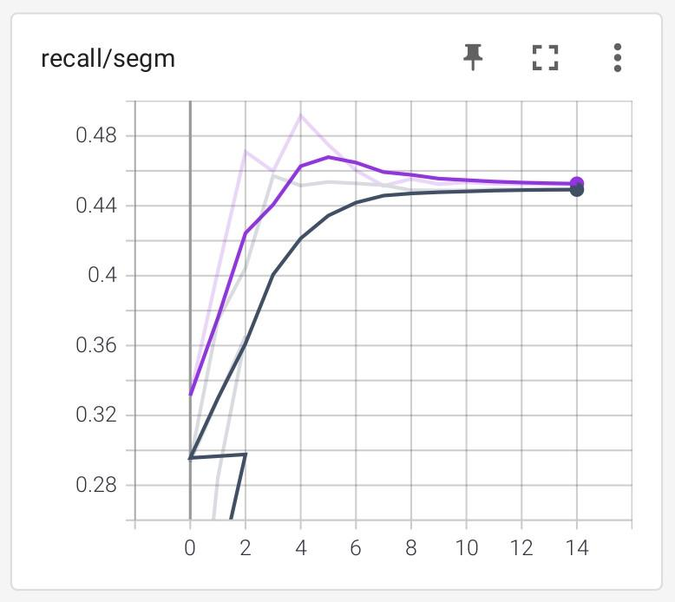
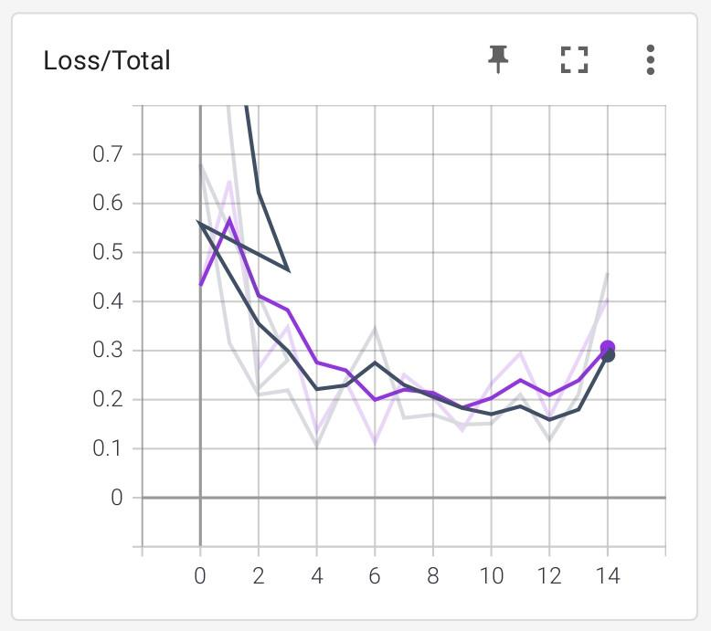
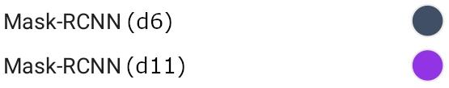
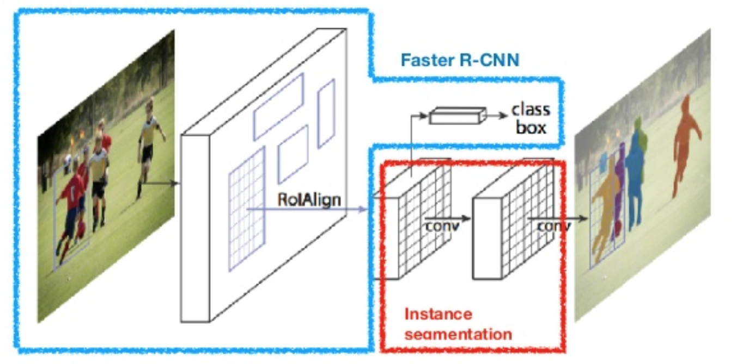
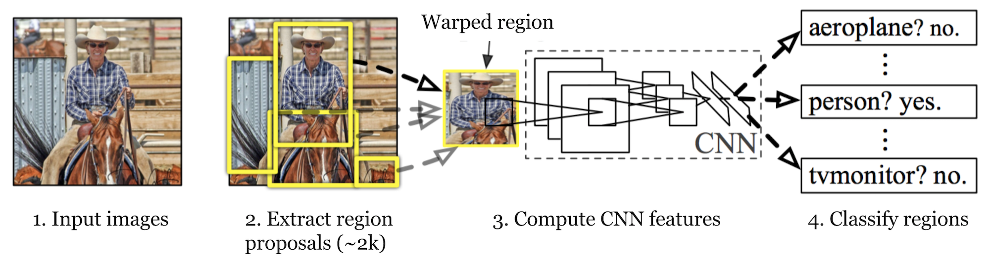
Contaminant Classifier
0.296
Notes:
To classify contaminants we trained a more complex deep learning model.
We could get into the details, but we will spare you that. Instead, we will show you what we were striving for and where we got.

Slide 16
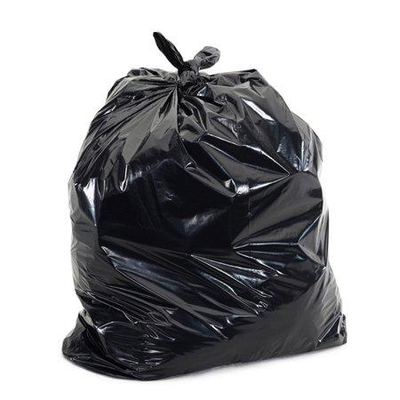
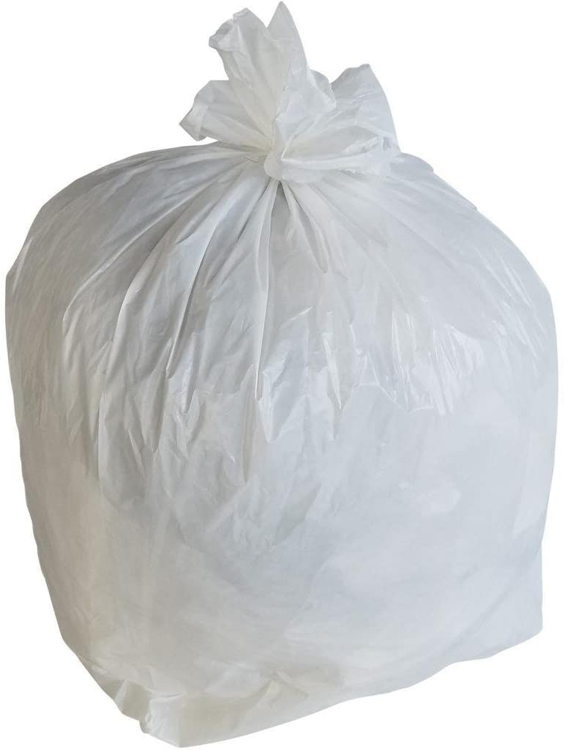
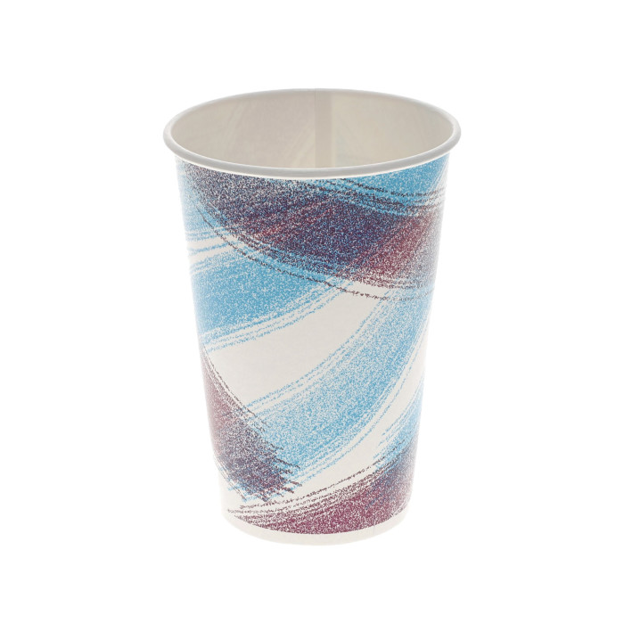
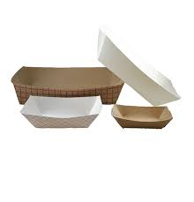
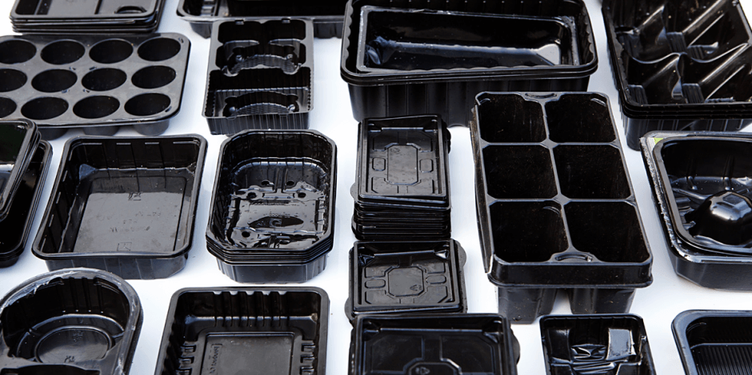
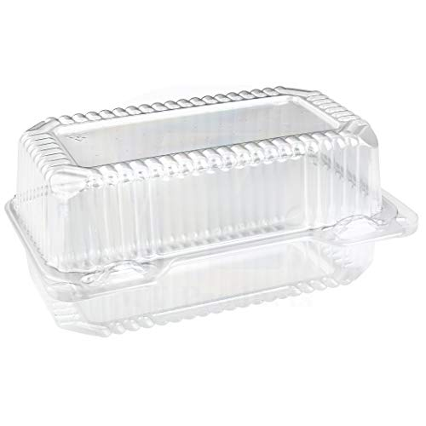
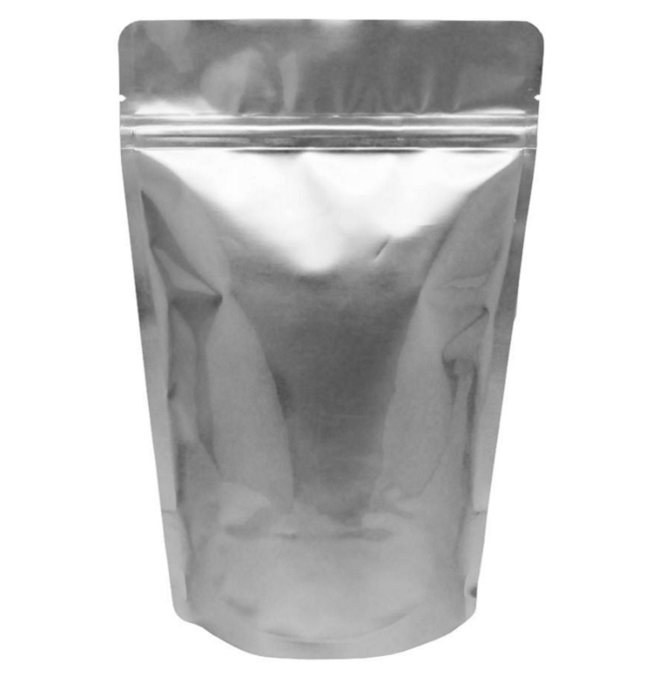
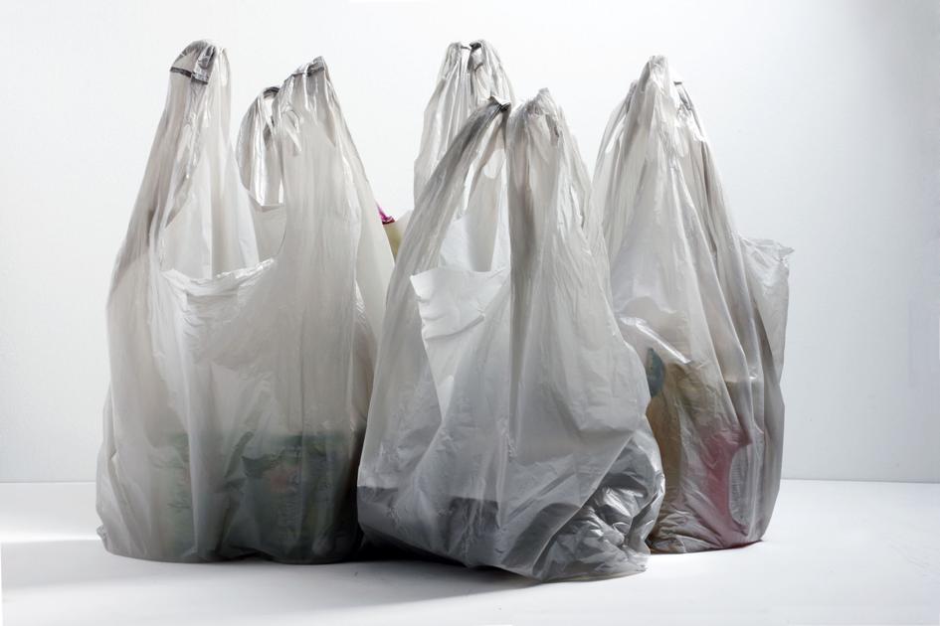
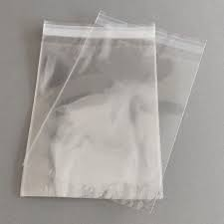
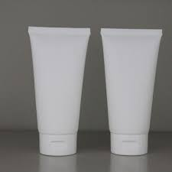
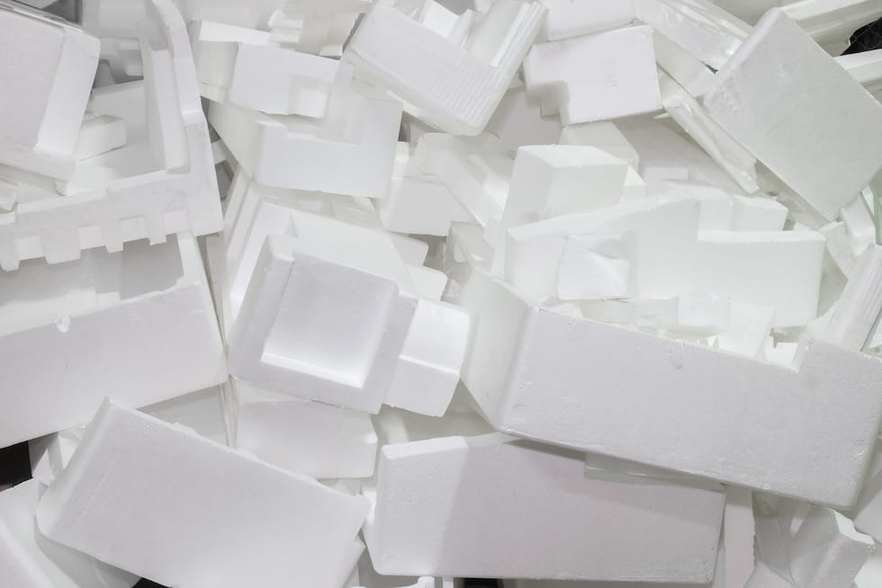
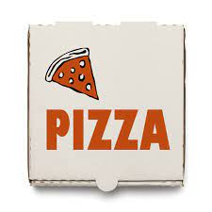
The Goal
Detect 12 most common contaminants of household recycling and do it with reasonable accuracy
*Note* Clamshell packaging, black plastics, and clean pizza boxes are recyclable in Regina
Each customer of StreamSight defines what they consider as contaminants
The variations across communities is in part why recycling is so difficult
Poly Coated Packaging
Black Plastics
Clamshell Packaging
Stand-up Pouch
Grocery Bag
Clear Plastic Bag/Film
Squeezable Tube
Styrofoam
Notes:
Our goal was to detect the 12 most common contaminants of household recycling and do so with reasonable accuracy.
We would like to note that clamshell packaging and black plastics as you see here in the bottom left are recyclable in Regina as well as pizza boxes.
Each customer of StreamSight defines what they want to consider as contaminants. These variations in the rules across communities is in part why recycling can be so difficult to do right.

Slide 17
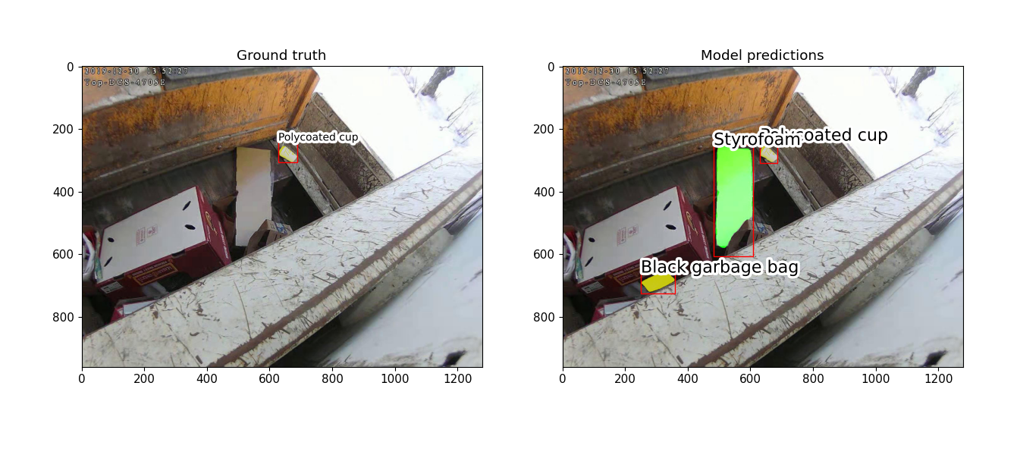
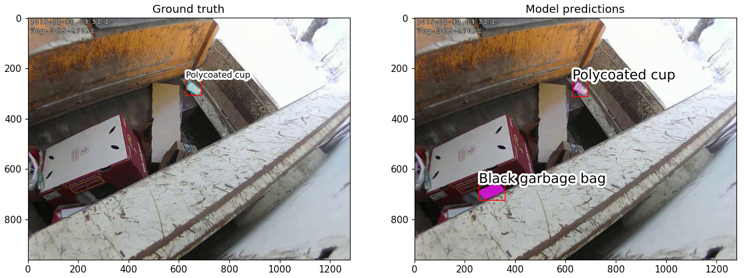
Predictions
Version 1 (d6)
Version 2 (d11)
Notes:
Here is a demonstration of some predictions. The image on the left is what we are expecting and the image on the right is what we received from our machine learning models.
Both models spotted the poly coated cup in the top right, but made some mistakes. The newer model performed better, not predicting the sheet of cardboard as styrofoam.

Slide 18
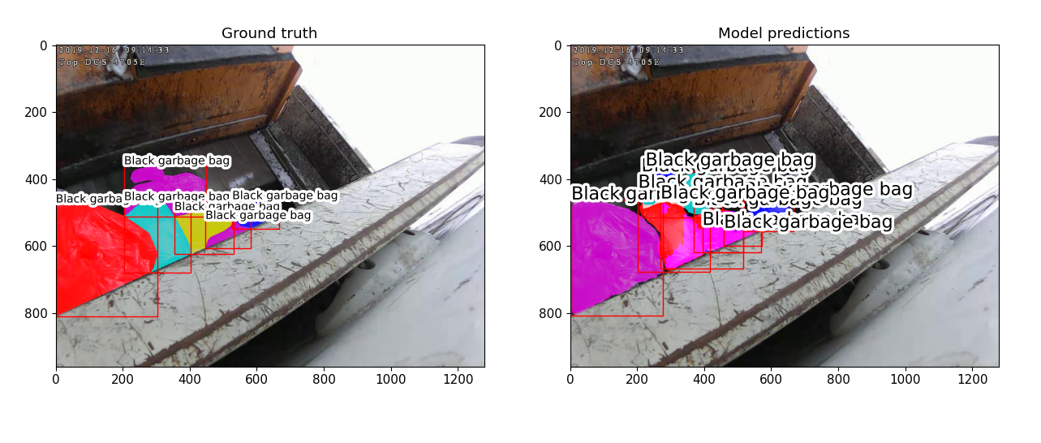
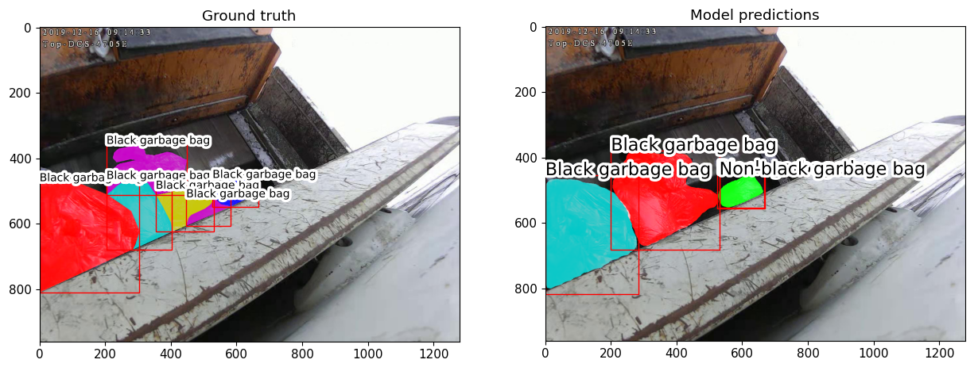
Predictions
Version 1 (d6)
Version 2 (d11)
Notes:
The older model did alright since it detects black garbage bags but does it far too frequently.
The newer model has significantly improved.

Slide 19
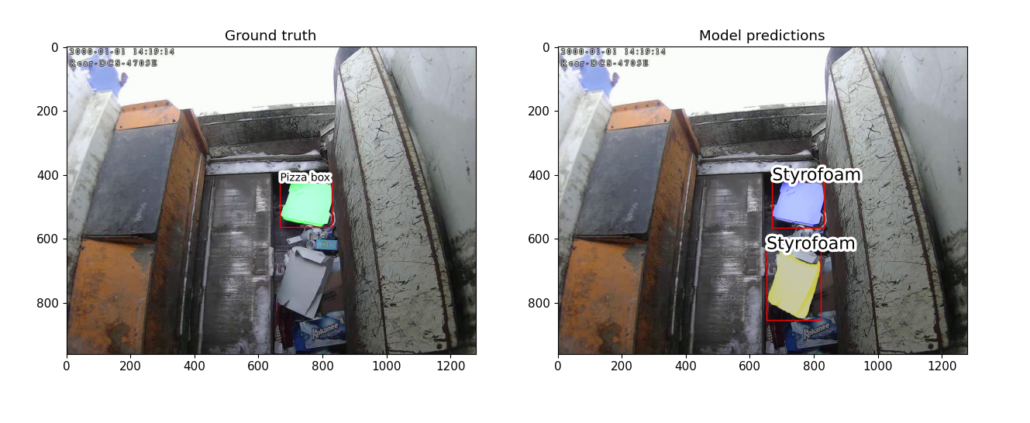
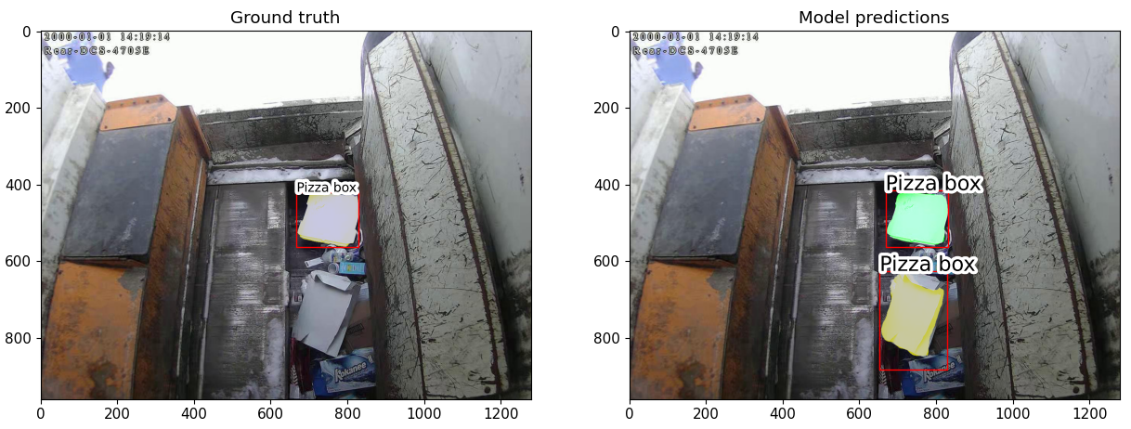
Predictions
Version 1 (d6)
Version 2 (d11)
Notes:
The older model struggled to differentiate between styrofoam and pizza boxes.
The newer model has improved and detects the pizza box.

Slide 20
How To Improve
Class ID | Category | # of Annotations
4 | Clear Plastic Bag/Film | 909
6 | Non-black Garbage Bag | 687
1 | Black Garbage Bag | 439
12 | Styrofoam | 436
3 | Clamshell Packaging | 263
5 | Grocery Bag | 194
8 | Poly Coated Cup | 145
2 | Black Plastic | 133
7 | Pizza Box | 129
10 | Squeezable Tube | 12
9 | Poly Coated Food Package | 6
11 | Stand-up Pouch | 0
More data
Results improved version d6 and version d11, only change was data increased from 900 total images to 1500
Nearly doubled # of images of contamination
Notes:
There is room for our model to improve. Between the two versions, the key difference is the amount of data available. With more images, we could see reasonable improvements in a future model.
Also, we have way more images of plastic bag varieties and styrofoam. This likely causes the model to over predict garbage bags and styrofoam. The recent addition of more pizza box images is likely why our model can now detect the pizza box correctly.
So, we can detect bin tips, and classify contaminants in recycling, how does our full software solution work?

Slide 21
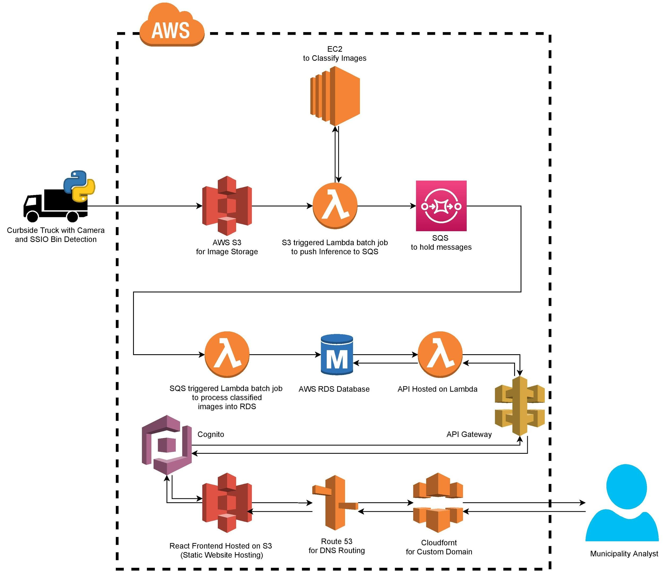
Image Pipeline and System
Architecture
Notes:
Our architecture is hosted in the cloud with Amazon Web Services.
The process starts on the Recycling truck with the camera. The truck takes pictures of the recycling as it is emptied into the truck. Then the truck uploads the images and we identify contaminants and store the data. When a municipality worker visits our website, we display this data to them to help them make informed decisions.

Slide 22


API Design
NestJS
Promotes great development practices
Authentication and Authorization
User must have required role to access API
https://dribbble.com/shots/3831862-Nest-JS-The-official-logo
https://icons8.com/icon/vMqgHSToxrJR/typescript
Notes:
Our backend, and connection to the database was built using the NestJS framework. It does a lot of things automatically for us, and easily enables great development practices.
RBAC:
We authorize users trying to use our API to make sure that they have the required role in their organization necessary.

Slide 23
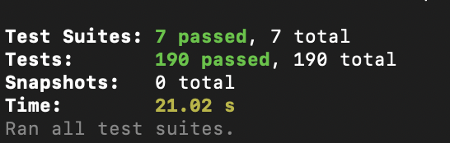
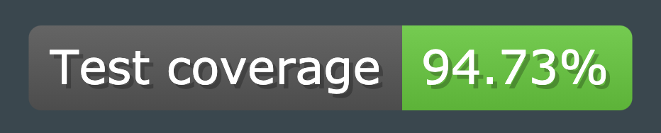

Quality Assurance
CICD Pipeline
Linting
Testing - 95% coverage
Deployment
User Testing
Code Reviews
Notes:
Quality Assurance:
Throughout the development process, there has been a focus on quality assurance.
We are using a Continuous Integration/Continuous Deployment Pipeline. A CICD pipeline makes sure that any of the code we are producing meets set standards.
For our tests, we created integration tests for our API. We have achieved approximately 95% code coverage for our API.
We went through some user testing where we received input about our front-end. Some of the key points brought up were font and style consistency, as well as choosing more clear descriptors for graphs and tables. Some additional components were added to the mapping page, such as an intensity slider.
Prairie Robotics also provided Code reviews. When merging in features and branches, PR would review, comment on implementations, ask questions and provide feedback for improvements before approving merges. We met regularly with PR to discuss challenges or design decisions that we made.
Our API was also professionally reviewed by an outside contractor. This has provided great feedback and insight on improvements and we worked to implement many of these changes to improve code quality.

Slide 24
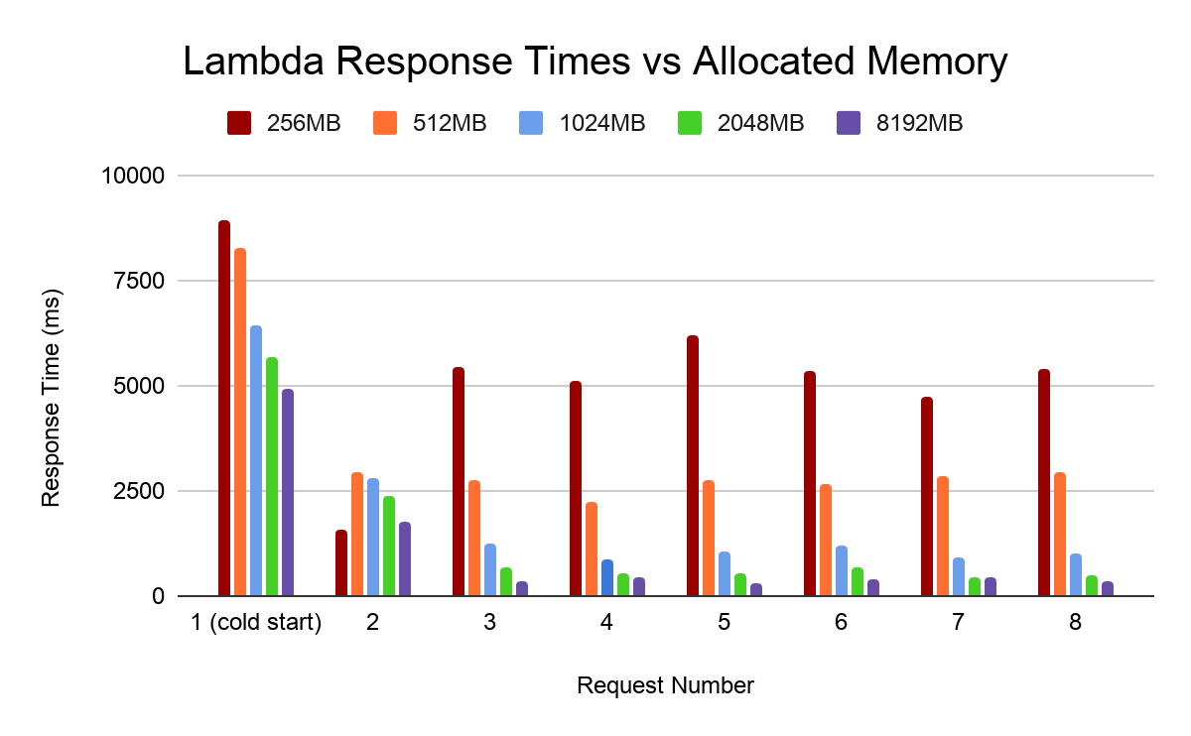
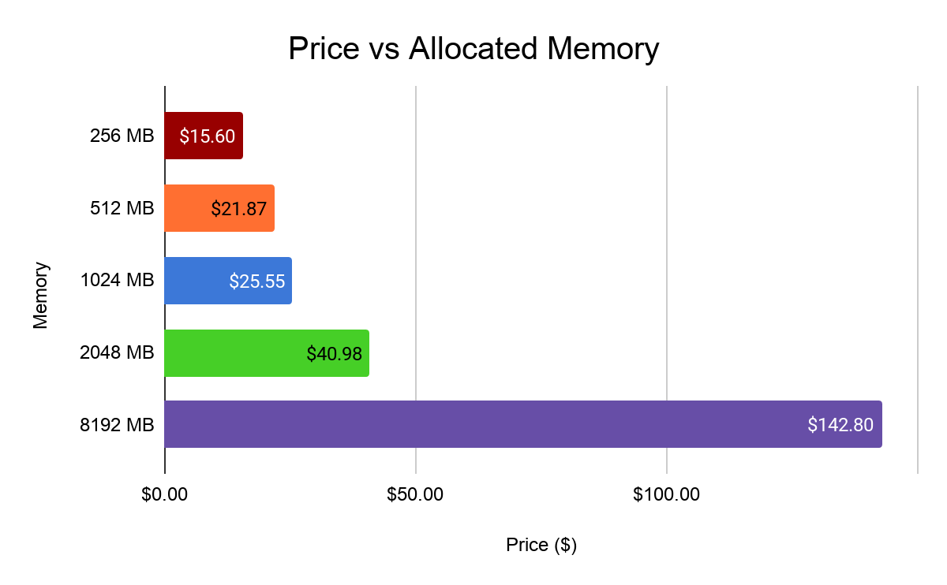
Pricing | API
2048 MB gives us a good balance of speed and cost
Notes:
We found that our API was too slow, taking about five seconds to load data on our map page, so we investigated different ways of speeding up its responses.
One meaningful change was increasing the amount of memory the API had access to. This lead us to improve response times substantially while not increasing our operating costs significantly. A faster response time means that our users will experience far less delay when trying to use our website and have an improved user experience.

Slide 25
Pricing | ML Training, Truck
Training of our contaminant classifier is about $0.75/hour
Takes about 2 and a half hours to train
Outfitting a truck with the necessary cameras and SSIO board is around $5000
Notes:
Our contaminant classifier costs us about $0.75 per hour to train in the cloud, and the classifier takes 2.5 hours to train.

Slide 26
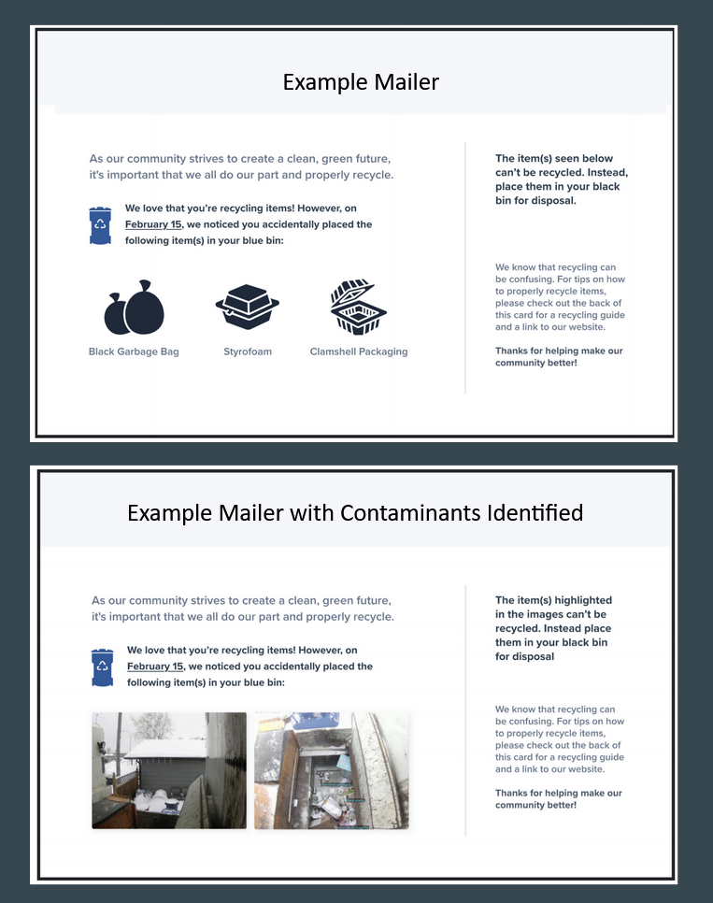
Future Work
Automatic Mailing Feature
Realtime Warnings for Vehicle Operators
Improve Contaminant Classifying Accuracy
Mobile App for Residential Users
Notes:
For future work, there are many directions the project can go.
We are handing the project over to Prairie Robotics and have built the system with future features and needs in mind.
One identified feature is a review function for municipalities to see pictures of infractions and confirm that a correct inference has been made. This would improve trust in the model.
A main feature that would assist in education would be the generation of mailers. This involves creating emails or postcards that could be automatically sent to residences with contaminants in their recycling. This would provide feedback, images of the contaminant and reasons why it couldn’t be recycled.
Additionally, if we could detect contaminants faster, the truck could provide real-time warnings for vehicle Operators. This could provide alerts for hazardous contaminants such as propane tanks. This would require possible hardware upgrades, and software modification.
Improving our contaminant detector is an ongoing goal. With additional data, data augmentation, and model modifications we could see substantial improvements.
Another addition to streamsight would be the creation of a mobile app for residential users. This would allow users to check if they recycled any contaminants and see their improvement overtime.
With URStreamSight, the future is exciting and we hope to make a difference in our community and the world at large with continuous improvements and innovations.

Slide 27

Other Relevant Documentation
Region of Peel study
Airdrie Report
Code Quality Review
Rationale Document
RBAC Explanation
Testing Plan
https://air.inc/blog/logos/Github-Logo-slack-theme
Notes:
Other Relevant Documentation:
Here is a list of some of our other relevant documentation available on GitHub. Go through each and say a little blurb about them.

Slide 28
Acknowledgements
University of Regina
Prairie Robotics
Dr. Timothy Maciag
Dr. Mohamed El-Darieby
George Daoud
Notes:
We would like to thank and acknowledge the efforts of the University of Regina and including the faculty and staff of the engineering department, prairie robotics, Dr. Tim Macaig, Dr. Mohamed El-Darieby, and George Daoud for helping us throughout our project.

Slide 29
Image References
https://dribbble.com/shots/3831862-Nest-JS-The-official-logo
https://icons8.com/icon/vMqgHSToxrJR/typescript
https://iconscout.com/icon/react-1
https://air.inc/blog/logos/Github-Logo-slack-theme
https://lilianweng.github.io/lil-log/2017/12/31/object-recognition-for-dummies-part-3.html
Region of Peel - Study on Enforcement for Reducing Blue Bin Contamination
https://pub-peelregion.escribemeetings.com/FileStream.ashx?DocumentId=4482
https://www.recycleacrossamerica.org/us-recycling-collapse
Notes:
Here are our image references from the presentation

Slide 30
Questions?

